Slide 1
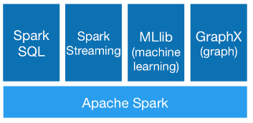

Slide 2
Starting Point: SparkSession
Entry point into all functionality in Spark SQL
Already created in pyspark
Need to create in self-contained applications:
from pyspark.sql import SparkSession
spark = SparkSession \
.builder \
.appName("Python Spark SQL basic example") \
.config("spark.some.config.option", "some-value") \
.getOrCreate()

Slide 3
DataFrames
Idea borrowed from pandas and R
A DataFrame is an RDD of Row objects
The fields in a Row can be accessed like attributes
>>> from pyspark.sql import Row
>>> row = Row(name="Alice", age=11)
>>> row
Row(age=11, name='Alice')
>>> row['name'], row['age']
('Alice', 11)
>>>row.name, row.age
('Alice',+11)
Note: Use row['name'] to avoid conflicts with row’s own attributes

Slide 4
DataFrame API
More examples:
https://www.cse.ust.hk/msbd/nb/sparksql.ipynb
RDD can be used to achieve the same functionality. What are the benefits of using DataFrames?
Readability
Flexibility
Columnar storage
Catalyst optimizer

Slide 5
Plan Optimization & Execution
Analysis
Logical
Optimization
Physical
Planning
Code
Generation
SQL AST
Unresolved Logical Plan
Logical Plan
Optimized Logical Plan
Physical Plans
Selected Physical Plan
RDDs
Cost Model
DataFrame
Catalog
DataFrames and SQL share the same optimization/execution pipeline

Slide 6
Plan Optimization & Execution
Analysis
Logical
Optimization
Physical
Planning
Code
Generation
SQL AST
Unresolved Logical Plan
Logical Plan
Optimized Logical Plan
Physical Plans
Selected Physical Plan
RDDs
Cost Model
DataFrame
Catalog
DataFrames and SQL share the same optimization/execution pipeline

Slide 7
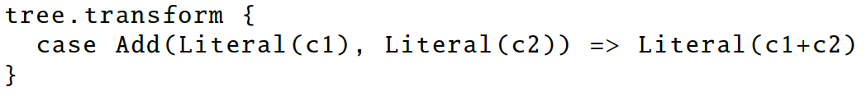
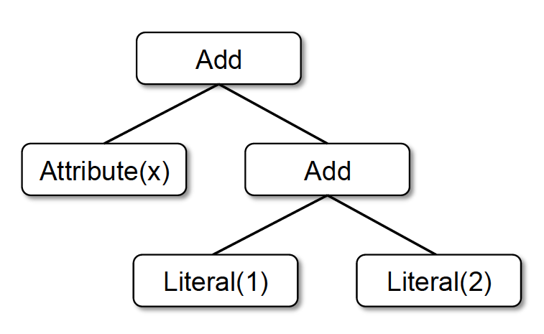
Tree transformations
Add
Attribute(x)
Literal(3)
x + (1 + 2)
x + 3
Notes:
Done in Scala because functional programming languages naturally support compiler functions.

Slide 8

Catalyst Rules
Pattern matching functions that transform subtrees into specific structures.
Multiple patterns in the same transform call.
May take multiple batches to reach a fixed point.
(x+0) + (3+3) => x + (3+3) => x+6
transform can contain arbitrary Scala code.

Slide 9
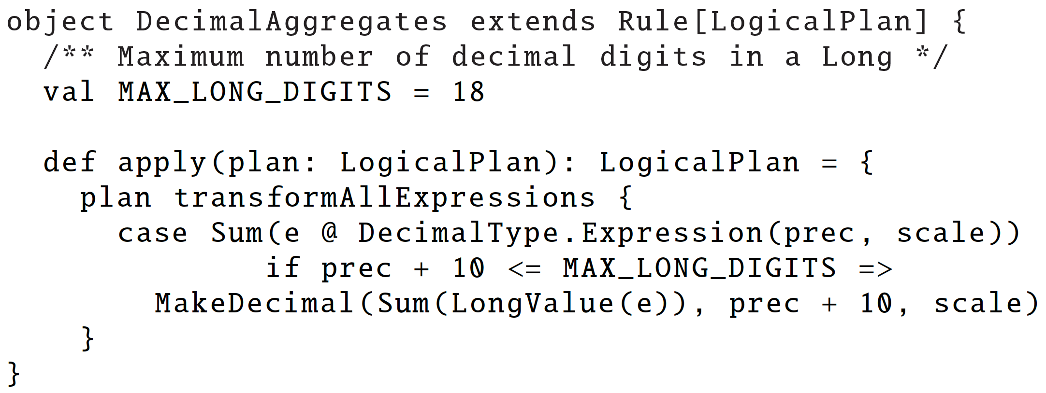
Applies standard rule-based optimization (constant folding, predicate-pushdown, projection pruning, null propagation, boolean expression simplification, etc)
Logical
Optimization
Logical Plan
Optimized Logical Plan
Example: Find expression SUM(x) where x is a DECIMAL(prec, scale). If prec is not too high, convert the SUM into a sum over LONGs, compute the sum, and convert the result back.

Slide 10
Rule-based optimization
events.join(users, ‘user_id’)
.filter(events.city == “Hong Kong”)
.select(events.timestamp, users.phone)
.show()
Logical Plan
Physical Plan
Physical Plan 2
select
select
join
filter
join
filter
select(user_id, phone)
join
filter
users table
select(user_id, city, timetamp)
users table
events table
users table
events table
events table
Predicate Pushdown
Column Pruning

Slide 11
Plan Optimization & Execution
Analysis
Logical
Optimization
Physical
Planning
Code
Generation
SQL AST
Unresolved Logical Plan
Logical Plan
Optimized Logical Plan
Physical Plans
Selected Physical Plan
RDDs
Cost Model
DataFrame
Catalog
DataFrames and SQL share the same optimization/execution pipeline

Slide 12
Cost-based optimization
Currently only used for choosing join algorithms
Big table joining big table: shuffle
Small table joining big table: broadcast the small table
Rewrite the PMI example using DataFrame API: https://www.cse.ust.hk/msbd/nb/PMI-SQL.ipynb

